Slide 1
CMS Control Records

Slide 2
Control Records . . .
Control records define the use of the Credit Management System (CMS) for your institution.
A control record is a collection of options and parameters that controls CMS processing and determines how CMS operates. You define and maintain the control records using online functions. Through the parameters selected on the control records, you define how your institution will perform CMS processing for different operations and environments. The control records in CMS include the following three high-level records, called primary records:
System record
Organization record
Logo record.

Slide 3
Control Records . . .
A collection of options and parameters which control the processing of the system
Defined and maintained online
CMS consists of 25 control records
System Record
CMS
Org Record
Logo Record
Secondary Records

Slide 4
Processing Calendar
Direct Debit Options
Interfaces
System
Record
Organization
Record
Organization
Record
Processing Calendar
Direct Debit Options
Report Parameters
Billing Date Assignments
Alpha Name Keys
Logo
Record
Logo
Record
Account Type
Visa/MC Parameters
Block Code Definition
Frequent Shopper Controls
Collections Parameters
Report Parameters
CMS
Primary Control
Record Overview

Slide 5
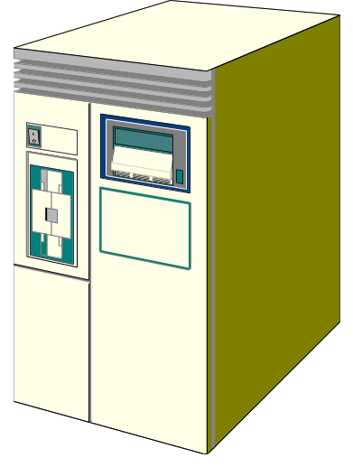




Primary Control Records
SYSTEM
998
ORGANIZATION
998
Private Label
VIP
Private Label
998
LOGO

Slide 6

Secondary Control Records
CMS has 22 secondary records which can be established as options under a controlling System, Organization or Logo record.
  Example: Interest, Insurance, Fees, Account Parameters

Slide 7
Processing Calendar
Direct Debit Settings
Interfaces
System
Record
Monetary
Transaction
General
Ledger*
Credit Plan
Master
Organization
Record
Organization
Record
Store
Demographics
Processing Calendar
ACH Information
Report Parameters
Billing Date Assignments
Alpha Name Keys
Logo
Record
Logo
Record
Account Type
Visa/MC Parameters
Block Code Definition
Frequent Shopper Controls
Collections Parameters
Report Parameters
CMS
Primary Control
Record Overview

Slide 8
Processing
Control Table
Account
Control Table
Service
Charge/Fee
Table
Insurance
Table
Interest
Table
Payment Due Days
Grace Days
Cash Limit
Annual Fee Disclosure
Min. Payment Amount
Disclosure Days
Late Fees
Over limit Fees
NSF Fees
Transaction Fees
Premiums
Maximum "at risk"
Balance
Premium Based on Max
Coverage
Cancellation Due to
Delinquency
Enrollment State by
Product
Interest Rates
Accrual Method
New Transaction Interest
Rate Index Table
Rate Variances
12 Rate Table Occurrences Per PCT ID

Slide 9
Processing
Control Table
Account
Control Table
Service
Charge/Fee
Table
Insurance
Table
Interest
Table
N Y
F L
V I P
G O V
Account Control Tables (998)
160
180
210
200
Service Charge/Fee Tables (998)
94
94
80
90
Insurance Tables (998)
115
115
111
120
Interest Tables (998)
RTOI 1
12
2
1
20
RTOI 2
13
3
1
22
RTOI 3
14
4
1
24
RTOI 12
15
9
1
2

Slide 10
More Secondary Records . . .
Statement Messages
Bar Codes
Relationships
Frequent Shopper
Fraud Data

